Slide 1
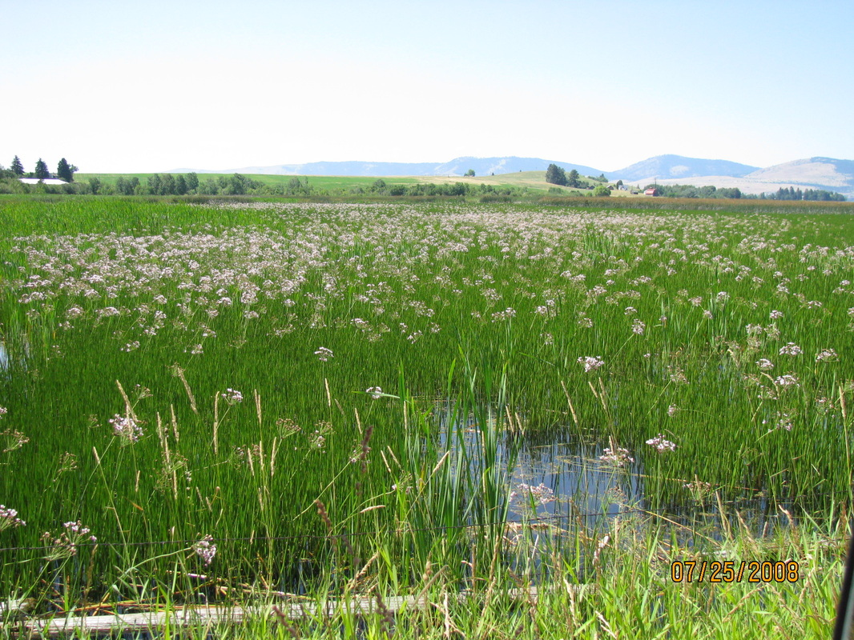
Optimal monitoring and management of invasive flowering rush in the Columbia River Brielle K Thompson UW-WSU Introduction to Structured Decision Making
Alvin Mitchell

Slide 2
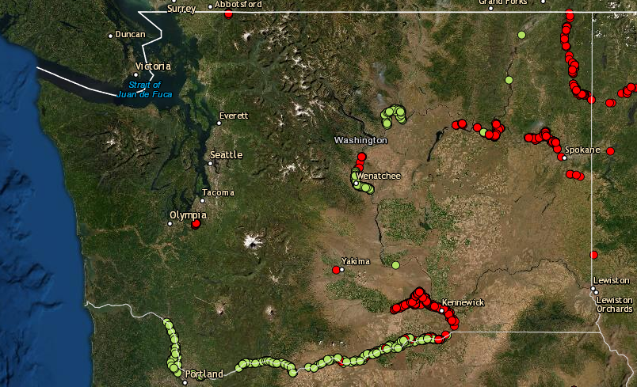

Flowering Rush
Alvin Mitchell
Columbia River
Not observed
Observed
Leslie J. Mehrhoff
Notes:
Invasive flowering rush, is a significant concern in the Columbia river basin. It can rapidly disperse, colonize, and produce dense stands of emergent and submerged growth that displace native vegetation and can provide habitat for invasive predator fish species that impact salmon populations. Dense stands compromise irrigation systems by blocking water transport and affect water-related recreational activities such as swimming, boating, and fishing.
https://columbiabasincwma.org/wp-content/uploads/2017/12/2019-ISAN_Flowering-Rush_Report-FINAL-Low-Res-080519_Revised2020.pdf

Slide 3

Problem:
The Columbia River Fish and Wildlife Conservation Office (CRFWCO) is eager to remove and monitor flowering rush within a 50km river area for 10 years
They aim conduct management to minimize overall presence and downstream spread of flowering rush
Also aim to minimize cost
Managers are constrained by the number of management segments (i.e., discrete 1 km sections of the river) on which they can conduct annual management and monitoring due to limited resources
Type: Dynamic problem, multiple objectives, information problem

Slide 4
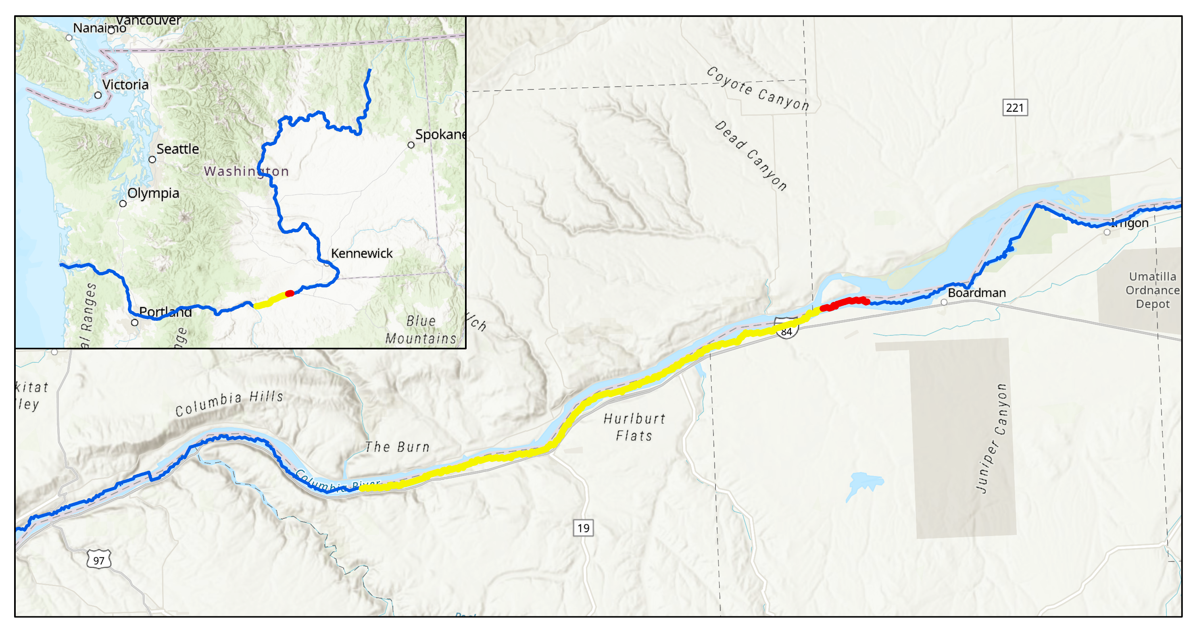
50 km length, divided into 50, 1km ‘segments’
Upstream
Invaded
Downstream
Empty
Columbia River

Slide 5
Objectives
Maximize the structure and function of aquatic resources of the Columbia River
Strategic
Minimize overall flowering rush presence
Minimize downstream presence of flowering rush
Minimize cost
Fundamental
*Average invasion state overall in the 50km section
(value between [0,1])
*Average invasion state in the final 5km downstream
(value between [0,1])
Minimize removal cost
Minimize monitoring cost
Means
$/yr
$/yr

Slide 6


Alternatives
Detection/Non-detection data Locations
Removal Location
Downstream segments*
Random segments*
Actions
X = Number of detection/non-detection locations
At the X next downstream segments
X = 0 segments
Random X segments
X = 5 segments
X = 10 segments
*Removal occurs at just 5 segments (5km total) every year
Notes:
And similarly we can develop our potential alternatives for flowering rush. Which again combines the removal strategies with the data collection strategies.
And an example of one alternative is the one highlighted in red. And this time, there might be multiple types of management for flowering rush.

Slide 7




Alternatives
Year 1
After 12 months of removal
*Removal occurs at just 5 segments (5km total) each month
Downstream removal & 10 next downstream observations
Downstream removal & 5 next downstream observations
Downstream removal & No observations
Random removal & 10 random observations
Random removal & 5 random observations
Random removal & No observations
Downstream
Upstream
After 12 months of removal and 5 detection/non detection observations...
Year 2
Downstream
Upstream
…
*Forward simulation adaptive management
Notes:
And similarly we can develop our potential alternatives for flowering rush. Which again combines the removal strategies with the data collection strategies.
And an example of one alternative is the one highlighted in red. And this time, there might be multiple types of management for flowering rush.

Slide 8


Adaptive management: forward simulation
Generate true system dynamics and monitoring data via a generating model
Decide & Take Action
Predict system dynamics via an estimation model
Predict Consequences
Monitor
Learning
Update Models
Adapted from Converse et al 2013, Williams and Brown 2014
Notes:
So I’ll describe the iterative framework that I use in my study. First we have a management decision and we take action. (Click)
Then we collect monitoring data and my project is a simulation study so I simulate true, real world dynamics and monitoring data with a generating model. And in this project, monitoring data just refers to removal data. (Click)
After we simulate the monitoring data, we use this information to update models that predict the system (Click)
And then we use an estimation model to predict the system dynamics. (Click)
Then we analyze the results from the estimation model and decide where we take action. And we continue this cycle through time.
So in this framework as we conduct our management and collect removal data, we are accumulating knowledge.
This approach to adaptive management is referred to as forward simulation, which is analogous to management strategy evaluation, and this process allows us to project complex system dynamics forward in time to inform rules of thumb management strategies that account for learning. There are other types of methods that are used in adaptive management (which I can explain if anyone is interested) but the forward simulation method is attractable because it can handle a high number of system states in comparison to other methods.

Slide 9
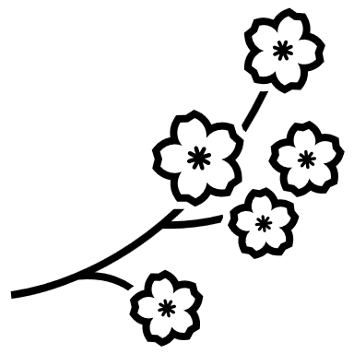


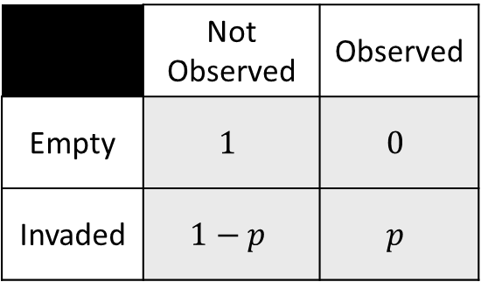
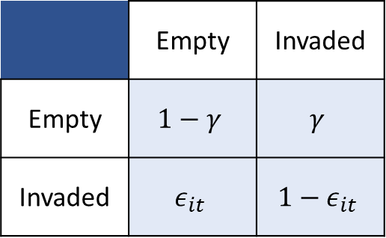

Generating and estimation model:
dynamic occupancy model
STATE TRANSITION
OBSERVATION
States
$Empty state$
$Invaded state$
Observation States
Not observed
Observed
Parameters ($i=site$, t = time)
$γ=Invasion probability$
function of the # of neighboring invaded sites
$e_{it}=Erradication probability$
Parameters
p = Detection probability conditional on being present
Not Observed
Observed
Observed State (t)
State (t)
 | Not Observed | Observed
Empty | $$1$$ | $$0$$
Invaded | $$1−p$$ | $$p$$
 | Empty | Invaded
Empty | $$1−γ$$ | $$γ$$
Invaded | $$ε_{it}$$ | $$1−ε_{it}$$
Empty
Invaded
State (t)
State (t-1)
Notes:
https://besjournals.onlinelibrary.wiley.com/doi/pdfdirect/10.1111/1365-2664.12234
https://besjournals.onlinelibrary.wiley.com/doi/pdfdirect/10.1111/j.1365-2664.2010.01915.x

Slide 10
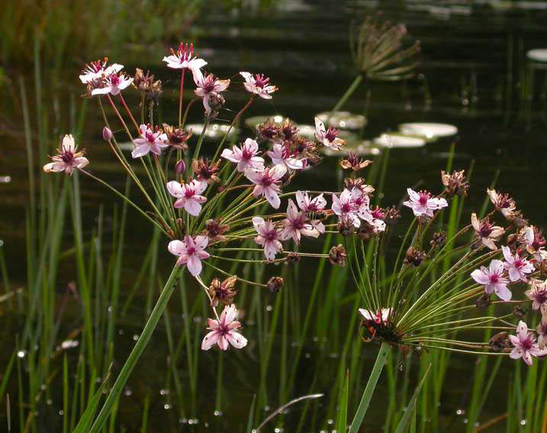
Consequences:
Minimize flowering rush presence
Minimize downstream spread
Minimize cost ($)
Minimize removal cost
Minimize monitoring cost

Slide 11
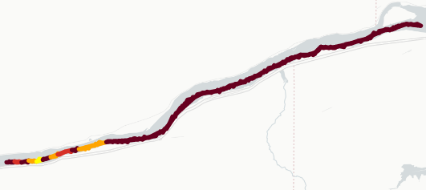
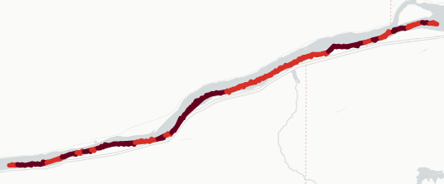
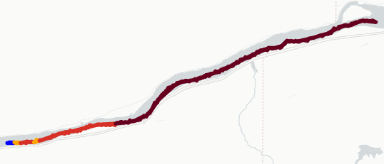
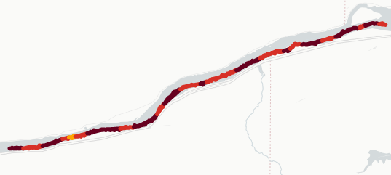
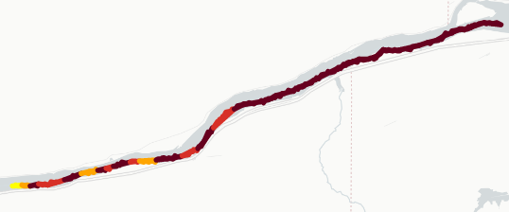
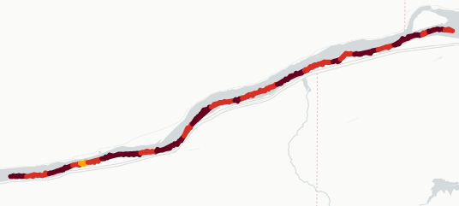
Consequences: true invasion states after 10 years
Downstream removal,
10 downstream observations
Random removal,
10 random observations
Downstream removal,
5 downstream observations
States
Random removal,
5 random observations
0.2-0.4
0.4-0.6
0.6-0.8
0.8-1
1 (Invaded)
Downstream removal, No observations
Random removal,
No observations

Slide 12
Consequences: minimize overall presence
State = 0 (Empty)
State = 1 (Invaded)
Best outcome
Worst outcome
Alternative | Minimize presence [0,1]
1. Downstream removal & 10 observations | 0.948
2. Downstream removal & 5 observations | 0.944
3. Downstream removal & No observations | 0.944
4. Random removal & 10 observations | 0.936
5. Random removal & 5 observations | 0.934
6. Random removal & No observations | 0.938
Irrelevant objective

Slide 13
Consequences: minimize downstream presence
State = 0 (Empty)
State = 1 (Invaded)
Best outcome
Worst outcome
Alternative | Minimize downstream presence [0,1]
1. Downstream removal & 10 observations | 0.82
2. Downstream removal & 5 observations | 0.68
3. Downstream removal & No observations | 0.78
4. Random removal & 10 observations | 0.98
5. Random removal & 5 observations | 0.94
6. Random removal & No observations | 0.88

Slide 14
minimize downstream presence & minimize cost
Consequences:
Alternative | Minimize downstream presence [0,1] | Minimize monitoring cost ($/yr)
1. Downstream removal & 10 observations | 0.82 | $10,000
2. Downstream removal & 5 observations | 0.68 | $5,000
3. Downstream removal & No observations | 0.78 | $0
4. Random removal & 10 observations | 0.98 | 10,000
5. Random removal & 5 observations | 0.94 | 5,000
6. Random removal & No observations | 0.88 | $0
State = 0 (Empty)
State = 1 (Invaded)
Best outcome
Worst outcome

Slide 15
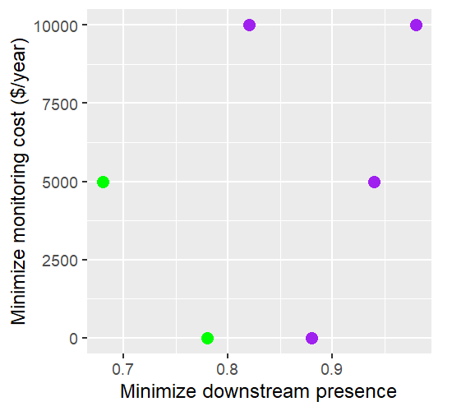
minimize downstream presence & minimize cost
Consequences:
Alternative | Minimize downstream presence [0,1] | Minimize monitoring cost ($/yr)
1. Downstream removal & 10 observations | 0.82 | $10,000
2. Downstream removal & 5 observations | 0.68 | $5,000
3. Downstream removal & No observations | 0.78 | $0
4. Random removal & 10 observations | 0.98 | 10,000
5. Random removal & 5 observations | 0.94 | 5,000
6. Random removal & No observations | 0.88 | $0
State = 0 (Empty)
State = 1 (Invaded)
Best outcome
Dominated
1
4
2
5
3
6

Slide 16
Value of sample information
State = 0 (Empty)
State = 1 (Invaded)
Best outcome
Alternative | Minimize downstream presence [0,1] | Minimize monitoring cost ($/yr)
2. Downstream removal & 5 downstream observations | 0.68 | $5,000
3. Downstream removal, No observations | 0.78 | $0
$$EVSI= EV_{w/info}−EV_{w/o information}$$
$$=0.68 −0.78=−0.1$$
12.8% decrease in invasion at the downstream segments

Slide 17
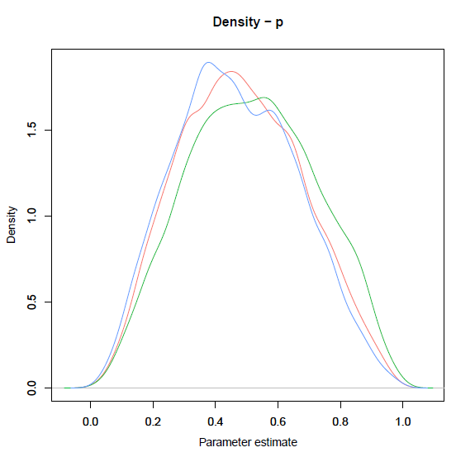
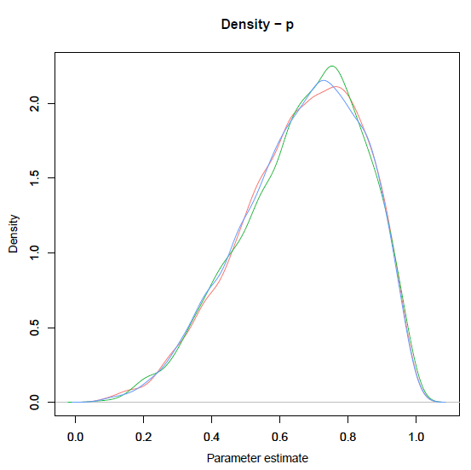
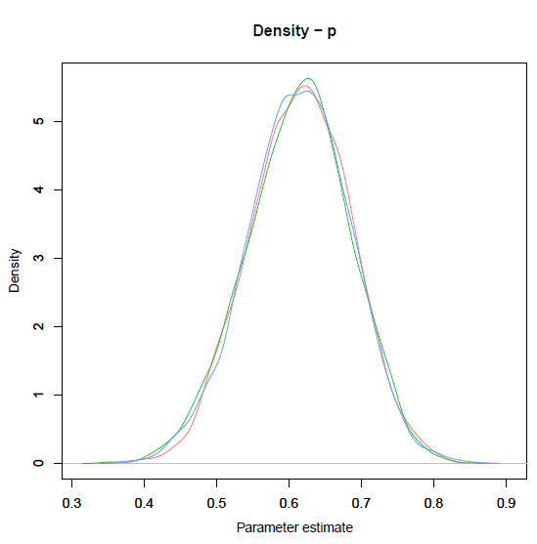
What do we miss out on when we don’t collect detection/non-detection data?
Learning!!
Example from: downstream removal & 5 downstream observations
Year 1:
detection probability prior Beta(1,1)
Year 10:
detection probability posterior
Year 1:
detection probability posterior
Truth = 0.6

Slide 18
Tradeoffs
State = 0 (Empty)
State = 1 (Invaded)
Best outcome
Alternative | Minimize downstream presence [0,1] | Minimize monitoring cost ($/yr)
2. Downstream removal & 5 downstream observations | 0.68 | $5,000
3. Downstream removal, No observations | 0.78 | $0
Swing weights | 0.79 | 0.21
Standardized consequence table → weighted preferences → Decision = Downstream removal &
5 downstream observations

Slide 19

Not Observed
Observed
Extension:
For each river segment i
Empty
Low abundance
High abundance
3 states
2 sources of detection non/detection data
Which type of data helps us manage better? Should we use them both? None?
Not Observed
Observed
(Low)
Observed
(High)
Notes:
https://besjournals.onlinelibrary.wiley.com/doi/pdfdirect/10.1111/1365-2664.12234
https://besjournals.onlinelibrary.wiley.com/doi/pdfdirect/10.1111/j.1365-2664.2010.01915.x

Slide 20
Thanks!
https://github.com/briellekwarta19/SDM_finalproject

Slide 21
Simple model
Models state transitions (including removal effort) for 12 months
Remove at random locations year 1
Vague priors
Detection/non-detection at month 12 at the random sites
Estimated states for month 12 inform management decision
Generating Model
(Year 1)
Estimation Model
(Year 1)
Generating Model
(Year 2)
Models state transitions (including removal effort) for 12 months
At month 12, collect detection/non-detection data
For example, collect data at randomly selected locations where removal did not occur that year
For example, choose sites for removal at most downstream invaded sites

Slide 22
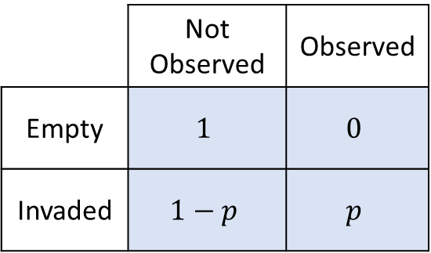
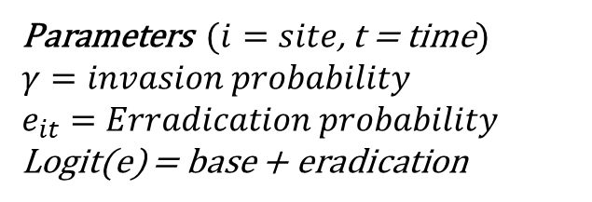
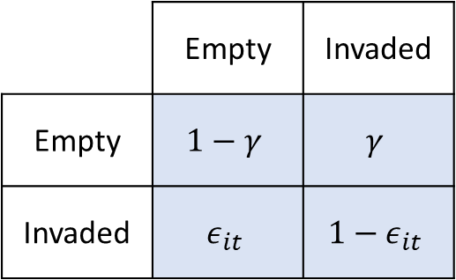
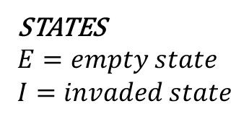
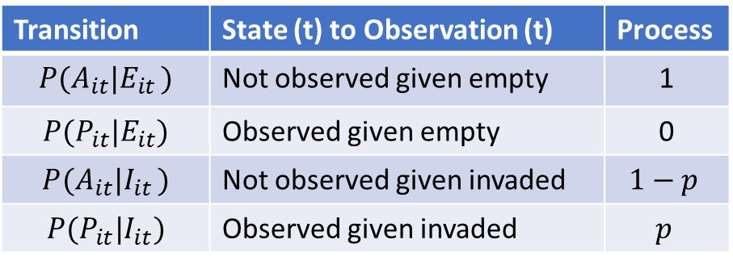
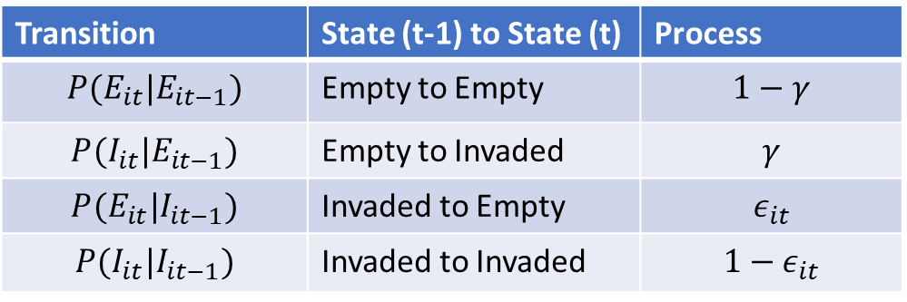
Transition | State (t-1) to State (t) | Process
$$P(E_{it}|E_{it−1})$$ | Empty to Empty | $$1−γ$$
$$P(I_{it}|E_{it−1})$$ | Empty to Invaded | $$γ$$
$$P(E_{it}|I_{it−1})$$ | Invaded to Empty | $$ε_{it}$$
$$P(I_{it}|I_{it−1})$$ | Invaded to Invaded | $$1−ε_{it}$$
Transition | State (t) to Observation (t) | Process
$$P(A_{it}|E_{it })$$ | Not observed given empty | 1
$$P(P_{it}|E_{it})$$ | Observed given empty | 0
$$P(A_{it}|I_{it })$$ | Not observed given invaded | $$1−p$$
$$P(P_{it}|I_{it})$$ | Observed given invaded | $$p$$
STATES
$$E=empty state$$
$$I=invaded state$$
Parameters ($i=site$, t = time)
$$γ=invasion probability$$
$e_{it}=Erradication probability$ Logit(e) = base + eradication
Observation
A = Not observed observation
P = Observed observation
Parameters
p = detection probability conditional on being present
Not Observed
Observed
State (t)
Observed State (t)
 | Empty | Invaded
Empty | $$1−γ$$ | $$γ$$
Invaded | $$ε_{it}$$ | $$1−ε_{it}$$
 | Not Observed | Observed
Empty | $$1$$ | $$0$$
Invaded | $$1−p$$ | $$p$$
State (t-1)
Empty
Invaded
State (t)
Notes:
https://besjournals.onlinelibrary.wiley.com/doi/pdfdirect/10.1111/1365-2664.12234
https://besjournals.onlinelibrary.wiley.com/doi/pdfdirect/10.1111/j.1365-2664.2010.01915.x

Slide 23
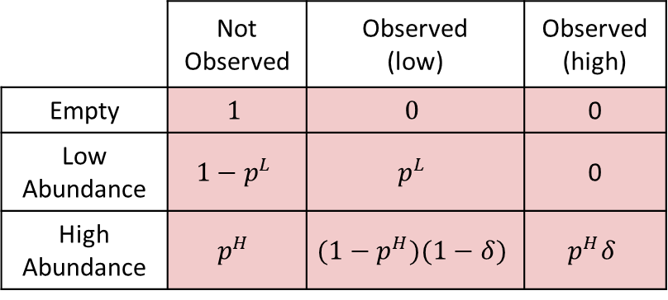
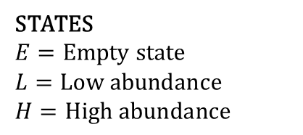
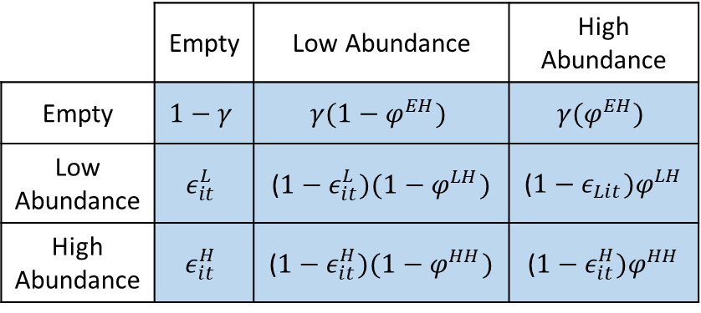
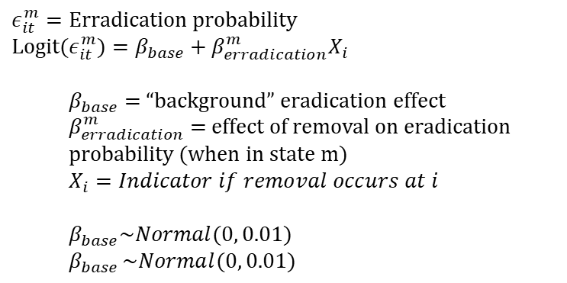
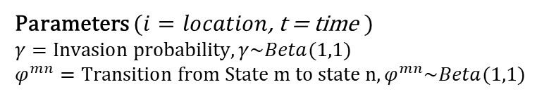
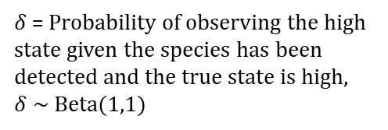
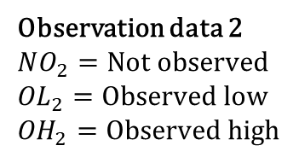
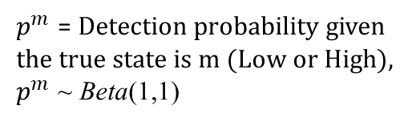
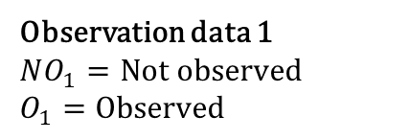
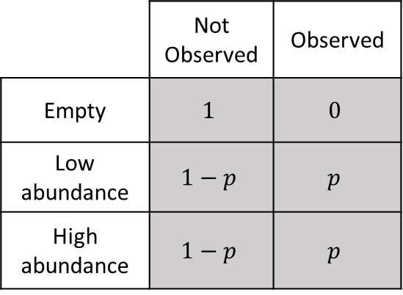
$ε_{it}^{m}=Erradication probability$
$${Logit(ε}_{it}^{m})=β_{base}+β_{erradication}^{m}X_{i}$$
$β_{base}$ = “background” eradication effect
$β_{erradication}^{m}$= effect of removal on eradication probability (when in state m)
$X_{i}=Indicator if removal occurs at i$
$β_{base}\sim Normal(0, 0.01)$
$$β_{base }\sim Normal(0, 0.01)$$
STATES
$$E=Empty state$$
$$L=Low abundance$$
$$H=High abundance$$
Parameters $(i=location$, t = time )
$$γ=Invasion probability, γ\sim Beta(1,1)$$
$$φ^{mn}=Transition from State m to state n,φ^{mn}\sim Beta(1,1)$$
State (t)
TRANSITION MATRIX
 | Empty | Low Abundance | High Abundance
Empty | $$1−γ$$ | $$γ(1−φ^{EH})$$ | $$γ{(φ}^{EH})$$
Low Abundance | $$ε_{it}^{L}$$ | (${1−ε}_{it}^{L})(1−φ^{LH})$ | (${1−ε}_{Lit})φ^{LH}$
High Abundance | $$ε_{it}^{H}$$ | (${1−ε}_{it}^{H})(1−φ^{HH})$ | (${1−ε}_{it}^{H})φ^{HH}$
$p^{m}$ = Detection probability given the true state is m (Low or High), $p^{m}$ ~ Beta(1,1)
State (t-1)
Observation data 2
$$NO_{2}=Not observed$$
${OL}_{2}=Observed$ low
${OH}_{2}=Observed$ high
$δ$= Probability of observing the high state given the species has been detected and the true state is high,
$δ$ ~ Beta(1,1)
 | Not Observed | Observed
Empty | $$1$$ | $$0$$
Low abundance | $$1−p$$ | $$p$$
High abundance | $$1−p$$ | $$p$$
Observation data 1
$$NO_{1}=Not observed$$
$$O_{1}=Observed$$
OBSERVATION MATRIX 1
 | Not Observed | Observed (low) | Observed (high)
Empty | $$1$$ | $$0$$ | 0
Low Abundance | $$1−p^{L}$$ | $$p^{L}$$ | 0
High Abundance | $$p^{H}$$ | $${(1−p}^{H})(1−δ)$$ | $$p^{H}δ$$
OBSERVATION MATRIX 1
p = detection probability conditional on being present,
p ~ Beta(1,1)
Notes:
https://besjournals.onlinelibrary.wiley.com/doi/pdfdirect/10.1111/1365-2664.12234
https://besjournals.onlinelibrary.wiley.com/doi/pdfdirect/10.1111/j.1365-2664.2010.01915.x

Slide 24
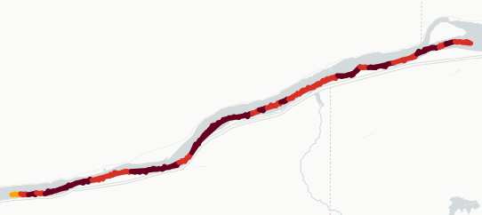
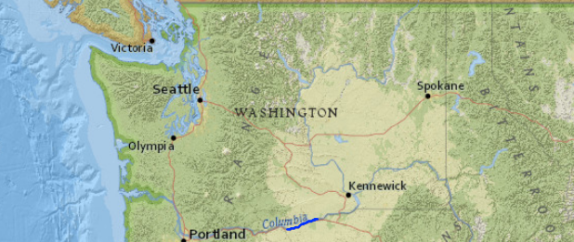
a.
e.
b.
f.
c.
g.
States
0.8-1
1
0.2-0.4
0.6-0.8
0.4-0.6
d.
h.

